Slide 1
Make Montessori
Work For You
PRESENTED BY [TRAINING CENTER NAME]
DATE

Slide 2
You’ve tried other ways to improve education, now try one that works for every child in every setting.

Slide 3
With over 100 years of proven practice, Montessori supports a child’s natural development to create capable, well-rounded students who become productive, fulfilled adults and lifelong learners.

Slide 4
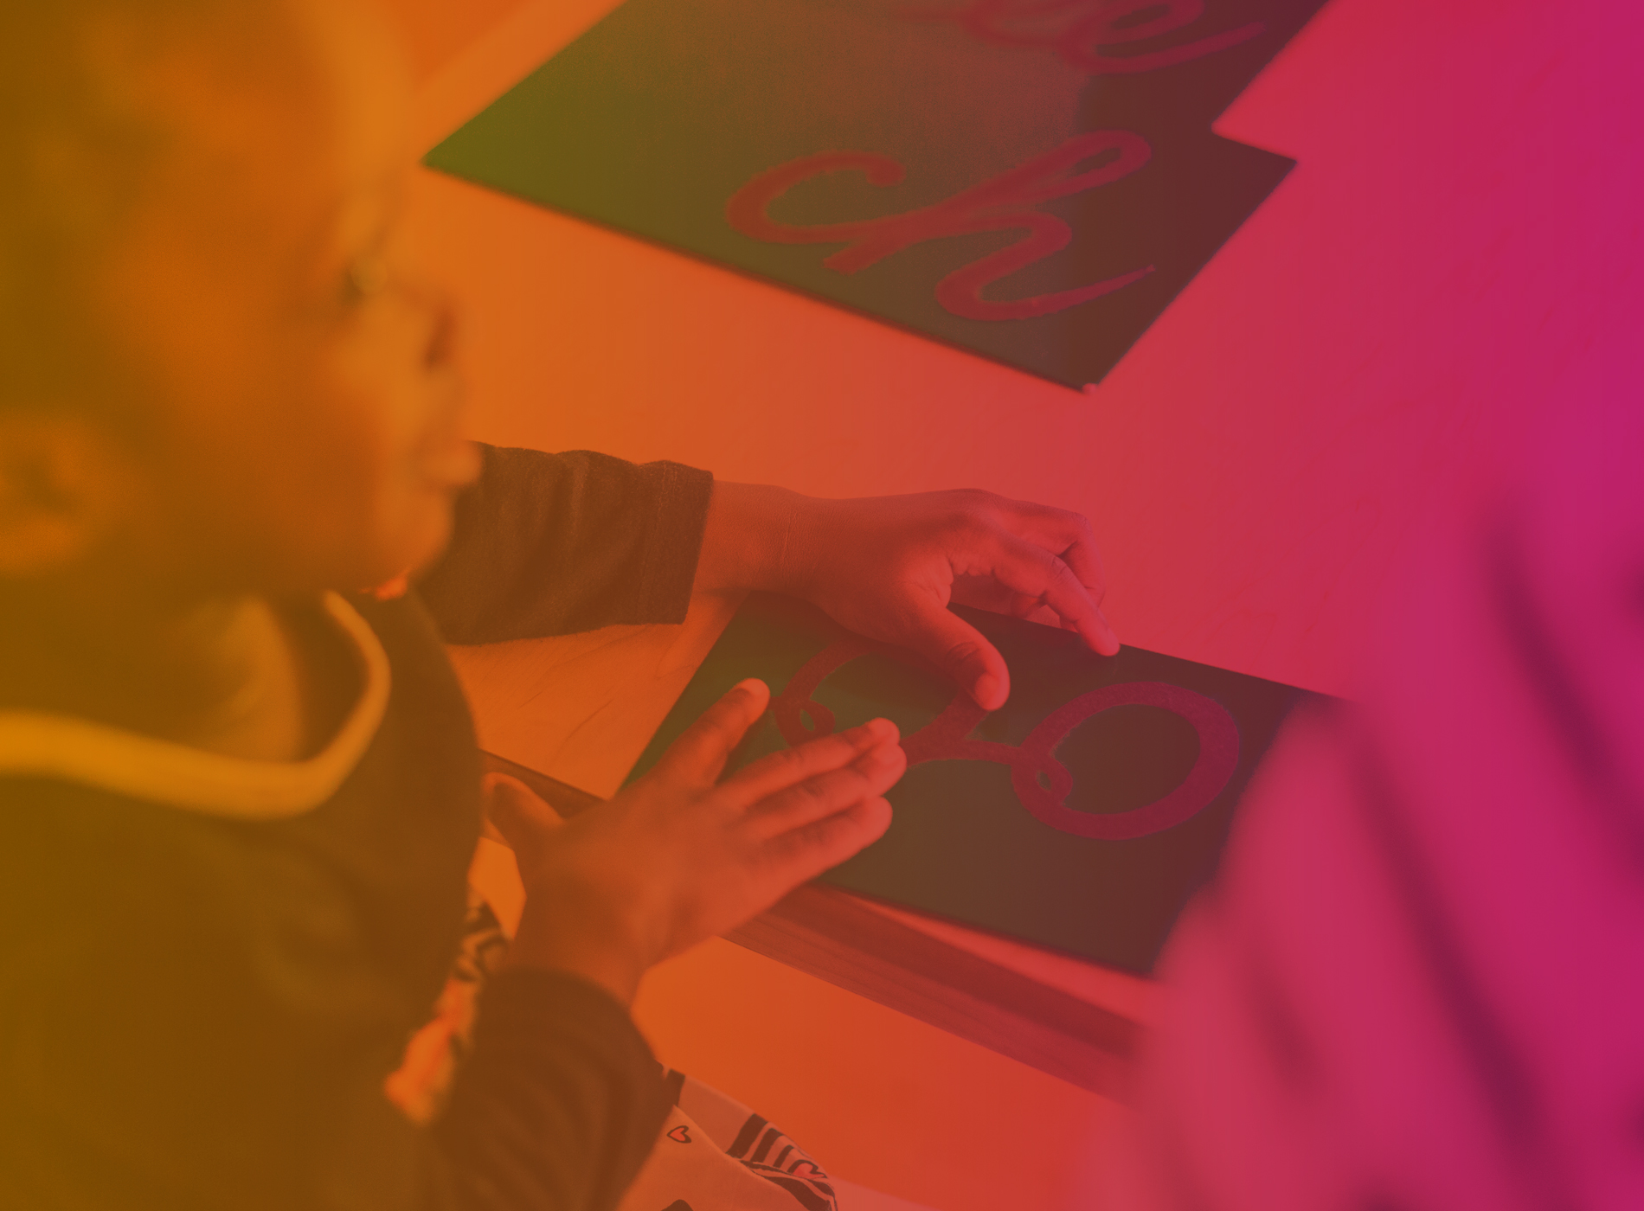
Montessori makes personalized education possible in public settings.

Slide 5
This is achieved through a rigorous, self-paced, collaborative, and joyful learning environment that increases achievement for all students.
Notes:
Montessori works because it personalizes education for each child while serving a group of children in a common classroom environment that facilitates independent and group learning.
Montessori can deliver results with more children in each classroom—because the children do the work while the teacher guides progress and success.

Slide 6
Montessori is the best way to close the achievement gap and move all children ahead, no matter where they begin.

Slide 7
“By the end of kindergarten, the Montessori children performed better on standardized tests of reading and math, engaged in more positive interaction on the playground, and showed more advanced social cognition and executive control. They also showed more concern for fairness and justice.” – Lillard study, 2017
Notes:
A recent study of Montessori magnet schools in Hartford, CT shows that all Montessori students had higher achievement than students in traditional schools.
In addition, low-income children performed at nearly the same rate as their more affluent peers, dramatically closing the opportunity/achievement gap without lowering expectations or standards. These exceptional results are mirrored in school districts in states as different as Texas and South Carolina.
1 Lillard, A. S., Heise, M. J., Richey, E. M., Tong, X., Hart, A., & Bray, P. M. (2017). Montessori Preschool Elevates and Equalizes Child Outcomes: A Longitudinal Study. Frontiers in Psychology, 8, 1783. http://doi.org/10.3389/fpsyg.2017.01783
2 Ford, T. (2015). Pro le of a Growing Urban School: The Lumin Experience. NAMTA Journal, v40, n2, p165-173. 3 Culclasure, B., Fleming, D.J., Riga, G., & Sprogis, A. (2018). An Evaluation of Montessori Education in South Carolina’s Public Schools. The Riley Institute at
Furman University. Unpublished manuscript.

Slide 8
Montessori is the education parents want for their children.

Slide 9
Parents want personalized education that balances intellectual and social and emotional development—having choices of education approaches, such as Montessori, provides greater satisfaction and confidence they are making the best possible choice for their child.
Notes:
According to a recent public opinion poll by Real Choices, offering different education approaches such as Montessori in public schools dramatically increases parental satisfaction with their schools and provides them with confidence that they can make the best possible choices for their child’s education.
Source: What Parents Want from Education: The Case for Real Choices. (2018). http://files.realschoolchoices.org/F_RealChoices_ResearchPaper_2018.pdf

Slide 10
Policies must allow for greater access to Montessori.

Slide 11
Montessori works—but it doesn’t check off all the boxes used to measure school success.

Slide 12
Montessori produces results because it’s different—and it needs policies that allow it to operate and be successful in public settings.
Notes:
These policies can be implemented without jeopardizing the quality of traditional schools.

Slide 13
Montessori works for students and parents—now make it work for you.

Slide 14
Flexibility in childcare licensing
Mixed age groups are a key part of the Montessori instructional model but many current policies prohibit mixed aged classrooms when they are often the key to better outcomes.

Slide 15
Enable Montessori programs to provide a highly effective learning environment where children learn to advance and care for each other while learning how to move ahead as an individual.

Slide 16
Teacher credential recognition
Montessori teachers are the most highly and rigorously trained teachers in the world. However, this globally recognized training is often not recognized by states as qualifying training for a state teaching license.

Slide 17
States should recognize certificates from accredited Montessori programs as valid credentials to earn a teaching license,
or provide a way for teachers to earn Montessori credentials and a state teaching license simultaneously.
Notes:
Montessori teachers learn by doing, similar to other programs with a student-teaching component, and although it is not based at a university, training includes the same type of in-depth study as other alternative teacher certificate programs.
There is even a K-12 Montessori Accreditation Council for Teacher Education (MACTE), which provides oversight and accreditation to training programs to ensure all programs are held to the highest standard.

Slide 18
Quality rating and improvement systems (QRIS)
These systems look for markers of school qualities that look different in a Montessori environment.

Slide 19
QRIS must be broad enough to recognize and assess the benefits of Montessori programs—they don’t look like traditional programs but go far beyond them in delivering high-quality learning environments, personalized teaching, and strong child outcomes.

Slide 20
Policies that accommodate Montessori can close the opportunity/achievement gap, provide what parents want for their children, and do what’s best for children now and in the future.

Slide 21
Montessori is the solution for your most pressing education issues.

