Slide 1
Marketing 101:
Reaching more students with Montessori

Slide 2
We must reach more parents
to bring the education approach that supports children’s natural development to more students.

Slide 3
Insights from recent AMI research inform ways we can better communicate the value of Montessori to parents from all walks of life throughout their children’s educational years.

Slide 4
The findings

Slide 5
Three key areas stand out where Montessori can provide the highest value to parents:
Helping children develop into capable individuals by focusing on their moral, behavioral, and emotional development;
Providing the highest quality teachers to facilitate that development; and,
Bringing parents into the Montessori experience so they can understand the process and aid in their child’s growth.

Slide 6
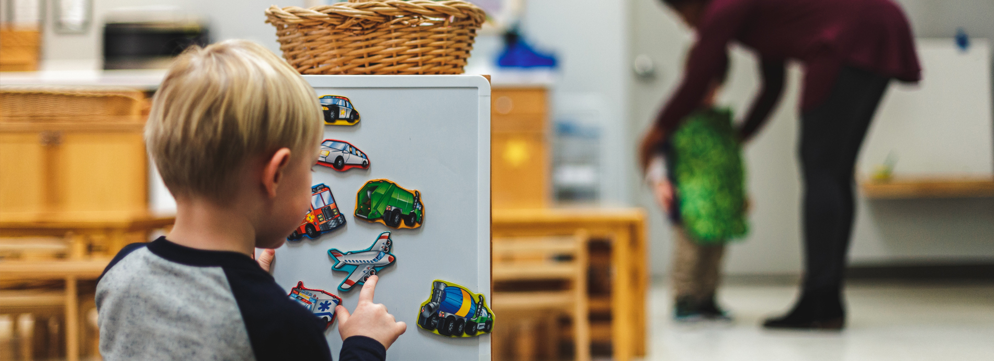
A capable individual is the most valued outcome of childhood development for potential Montessori parents.

Slide 7
The Montessori curriculum is important to Montessori parents, but when choosing a program for their child, teacher quality is the highest priority.

Slide 8
Montessori leaders place emphasis on pedagogy and classroom environment to evidence program quality and fidelity—but parents judge quality by their interactions and relationships with Montessori teachers.

Slide 9
Positioning teachers at the forefront of Montessori will accomplish two important objectives:
It will attract more teachers because they will understand that they are respected, supported, and empowered;
It will send parents clear messages that the quality of Montessori lies in the preparation of its teachers and will contribute to parental preference for programs with the most highly trained and skilled teachers.

Slide 10
American parents have a strong sense of personal agency when it comes to education and see educators as partners in child development, not replacements.

Slide 11
Parents seek Montessori as a partner to help them develop their children into capable individuals—but they often feel pushed away.

Slide 12
Montessori is intensely focused on the development of the individual child, but your developmental approach must also make space for the parent—they need attention, encouragement, explanation, and confidence to stick with you.

Slide 13
Montessori begins to lose students in the transition grades of K-12—retention is critical not only for child development, but to develop a strong and appealing Montessori community that drives demand and advances the mission.

Slide 14
There is a misconception among parents that Montessori focuses on socioemotional development at the expense of academics and knowledge building.

Slide 15
Montessori doesn’t speak enough about knowledge building and the exceptional ways in which you do it —it must be clear that academics and knowledge building are key qualities of Montessori.

Slide 16
While Montessori parents very much want a just and equitable world, they believe we create it by developing just and equitable individuals through Montessori education.

Slide 17
Social justice means greater access to Montessori—and only Montessorians can create that by attracting more teachers and creating more schools in more communities.

Slide 18
Messaging

Slide 19
What it means strategically:
We have them at hello—provide the confidence for parents to follow their intuition, select the program, and stick with it.
Teachers need to be visible, acknowledged, and multiplied.
Be for the parent—make them a partner in the experience.
Take credit for building knowledge.
Great effort should be put into scaling and retention.
Social justice is access to Montessori.
You need better, more, and more coordinated communication.

Slide 20
Parents don’t always know what Montessori is, but they believe it is ideal and want it for their children.

Slide 21
They rely on Montessori to help them develop the moral, emotional, and behavioral abilities that they understand to be key to helping their children become capable individuals.

Slide 22
THE MESSAGE FRAME
Montessori works in every setting for the success of each child.
We help parents develop children who are morally, emotionally, and behaviorally prepared for the real world.
Our teachers support your child’s natural development, building the capability to become productive, fulfilled adults who contribute to the world.
Teachers help children follow their interests and passions to develop strong skills in academics, leadership, self-discipline, responsibility, independence, and initiative.
Our classrooms are hands-on, self-paced, collaborative, and joyful, creating a lifelong learner and doer.

Slide 23
What this means for marketing your school

Slide 24
Highly developmental approaches that help children become capable, productive, fulfilled adults who contribute to the world are in high demand from parents.

Slide 25
Tailor your message and outreach strategy—help parents understand how the Montessori approach can help them accomplish their goals as a parent.

Slide 26
Meet parents where they are regarding what they want for their child and welcoming them into their child’s learning experience.

Slide 27
Incorporate the frame into your regular communications to build confidence in current and potential parents that choosing your school is choosing the best-possible education to nurture their child’s full potential.
Notes:
The message frame relays what is unique and important about Montessori training, teachers and schools - a framework for successful teaching that works for each child, regardless of their socioeconomic status.

Slide 28
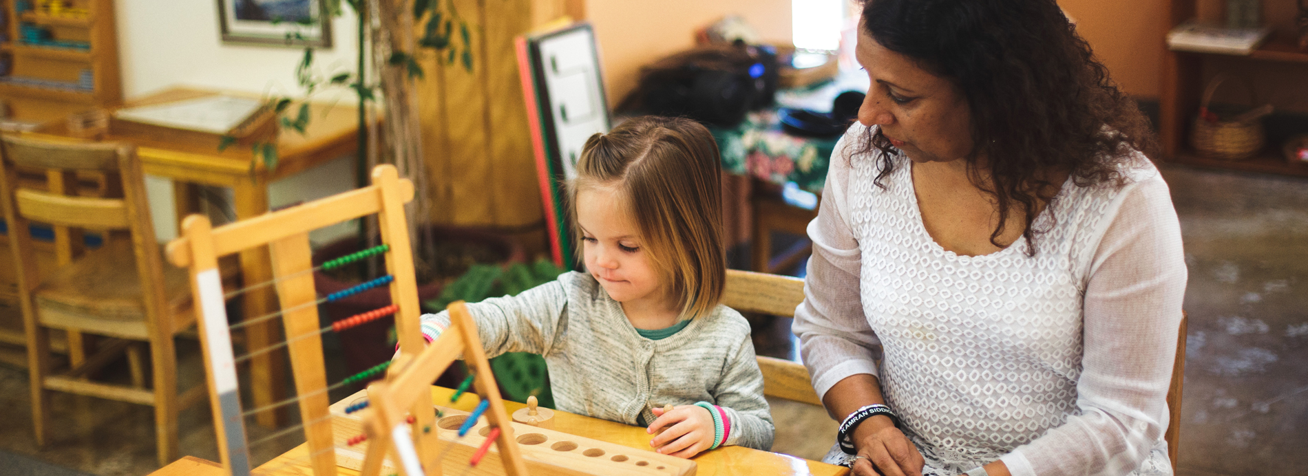
Your best marketers are current parents who already have positive relationships with your teachers and who know the impact Montessori is making for their child.
Notes:
Many of you mentioned word of mouth is crucial in spreading the word about your school. Parents of your current students are the best spokespeople when it comes to talking about the difference Montessori is making for their child and their family. Engage them in your current efforts to tell the story of their child’s experience with Montessori.

Slide 29
Marketing tactics

Slide 30
Survey feedback
Parents outrank your other audiences by far.
Your current marketing efforts range from none at all to local advertising and event presence to parent engagement efforts to Google AdWords.
Facebook is the most common channel used, though email newsletter is not far behind.
How to use effective messaging to reach your target audience is ranked as the most valuable knowledge to gain.

Slide 31
The good news is that we know from our research how to reach parents by communicating that Montessori is their partner in helping to raise a capable child.

Slide 32
When possible, seek feedback about why parents chose Montessori for their child.

Slide 33
Use the insights you gain from that feedback to tweak messaging and outreach, plan future marketing efforts, and invest your resources in the tactics that are proven.

Slide 34
Resources developed from the parent research can arm your teachers and staff to more effectively reach current and potential parents to advance your mission.
Notes:
We’ve developed resources to help you engage current parents and provide them with tools to be advocates for your school.

Slide 35
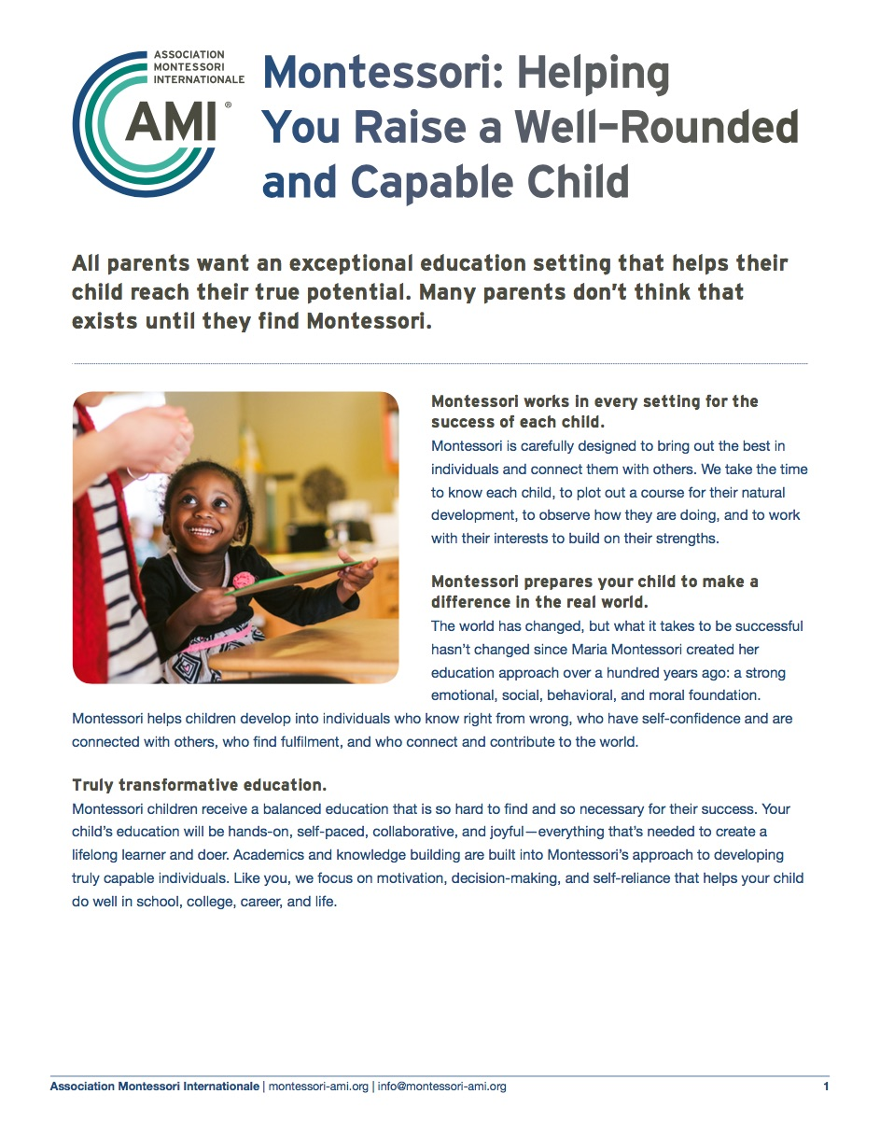
Parent outreach
Notes:
Applying the core messaging from the 2017 parent motivation research, this leave-behind document is intended for schools to share with parents, as well as potential parents, interested in the value that Montessori offers their child and their family. It describes the education environment parents can expect from Montessori and the reassurance parents need that their child will receive a truly transformative education that fits their needs at each developmental stage.
This presentation is intended for schools to use with prospective parents or as an introduction to parents of children new to the Montessori approach, such as at the beginning of a new school year. Designed to take about 30 minutes, the slides walk parents through what they can expect from their child’s Montessori education and reassures them that Montessori is their partner in preparing their child for success in school and in life.

Slide 36
Parent engagement
Notes:
One insight from the 2017 Montessori parent research is that parents often feel disengaged with what their children are learning and experiencing each day. This resource is designed to guide parents through questions and prompts to pose to their child to encourage conversation and discussion about what they are learning in school. It is ideal for younger children in the 3-6 and 6-12 classrooms.

Slide 37
Social graphics
Notes:
Social media graphics that incorporate the message frame can support your current efforts on your school’s various social media platforms, from Facebook to Instagram to Twitter.

Slide 38
These and other resources from the parent research can be downloaded here:
https://montessori-ami.org/resource-library

Slide 39
Thank you

